Slide 1
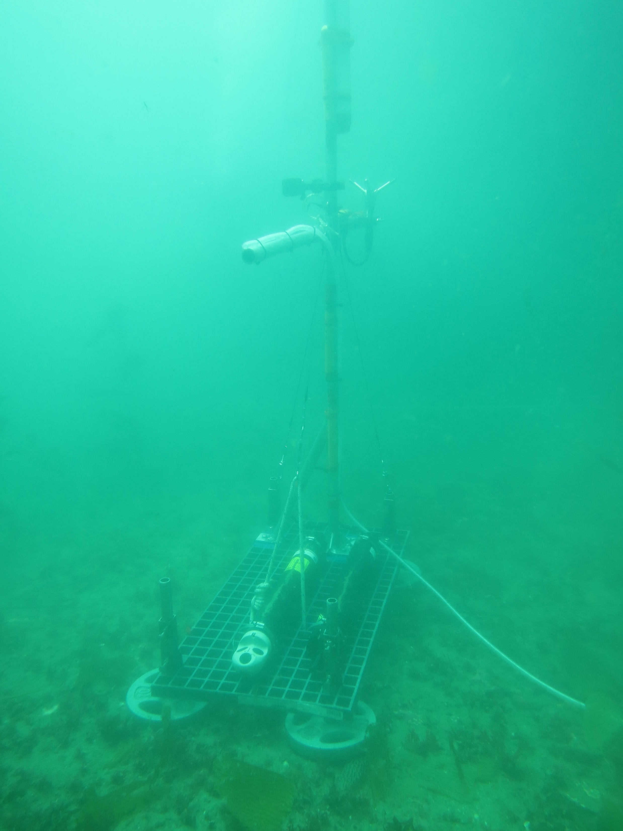

AquaDopp Kelp Forest Dye Release Lander Experiment
Release 1 Data Processing
Jason Rooker
Dr. Derek Grimes
Summer 2025

Slide 2
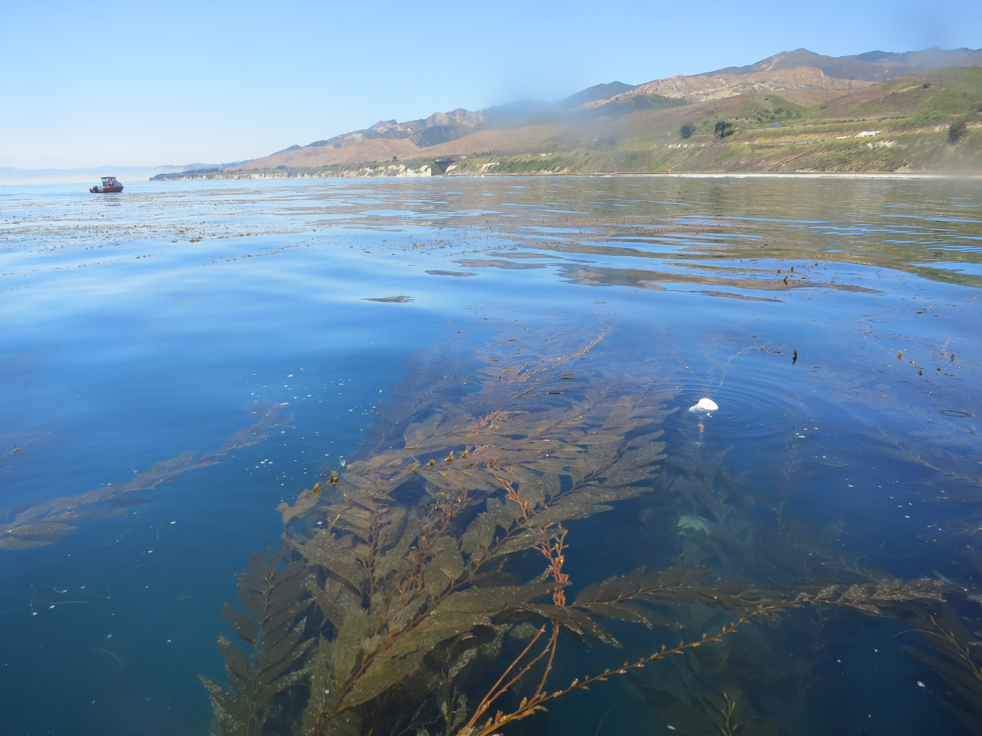
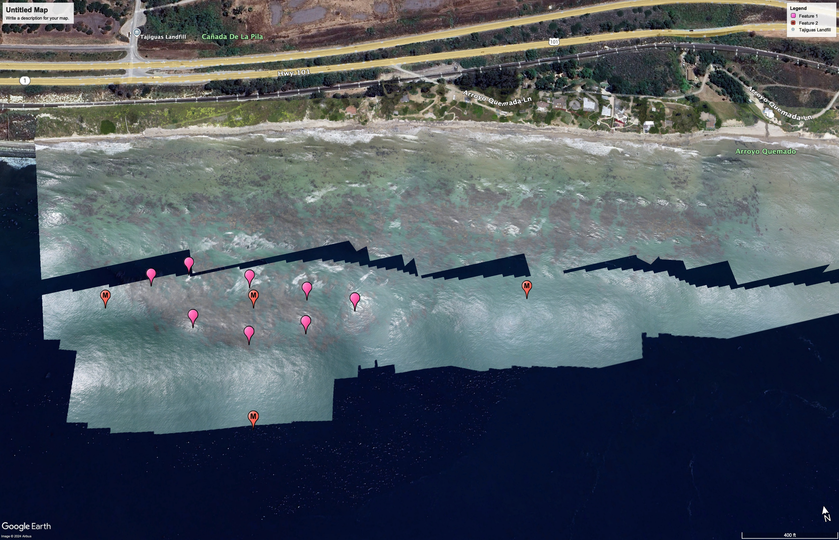
Experiment Setup: Santa Barbara County, CA

Slide 3
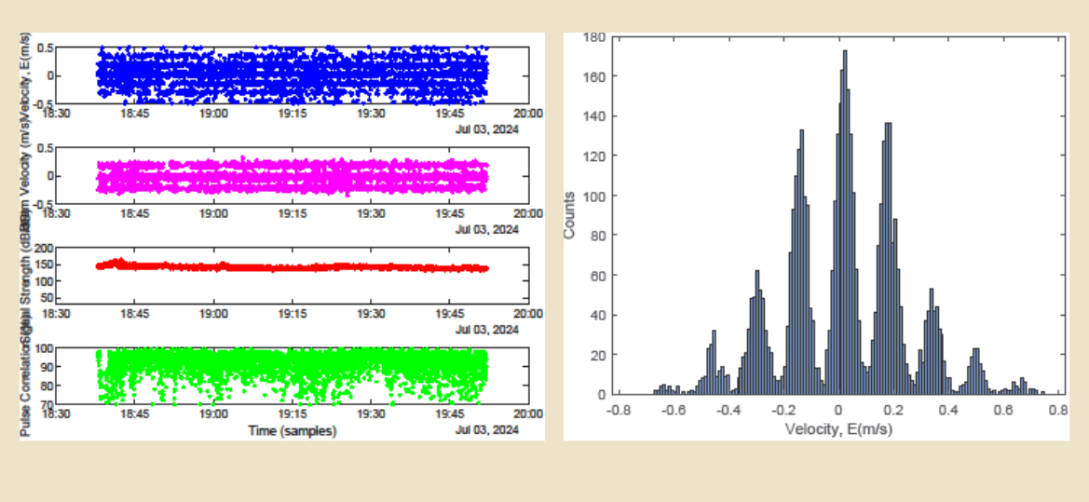
Release 1 Raw AquaDopp Data

Slide 4
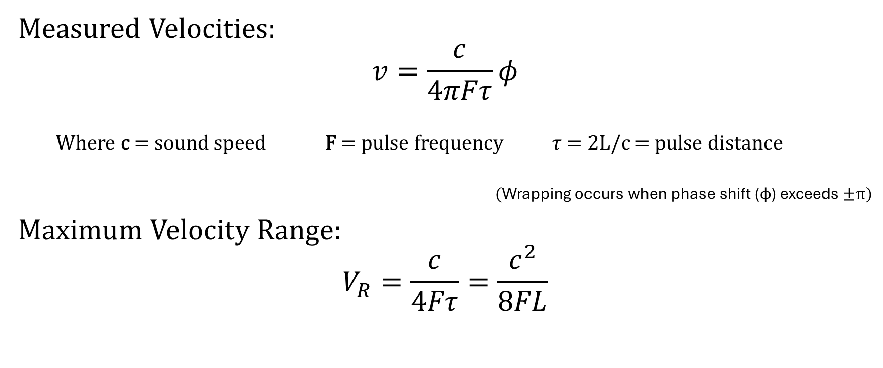
Velocity Wrapped Data
Measured Velocities:
$$v=\frac{c}{4πFτ}φ$$
Where c = sound speed F = pulse frequency $τ$ = 2L/c = pulse distance
(Wrapping occurs when phase shift ($ϕ$) exceeds $±π$)
Maximum Velocity Range:
$$V_{R}=\frac{c}{4Fτ}=\frac{c^{2}}{8FL}$$

Slide 5
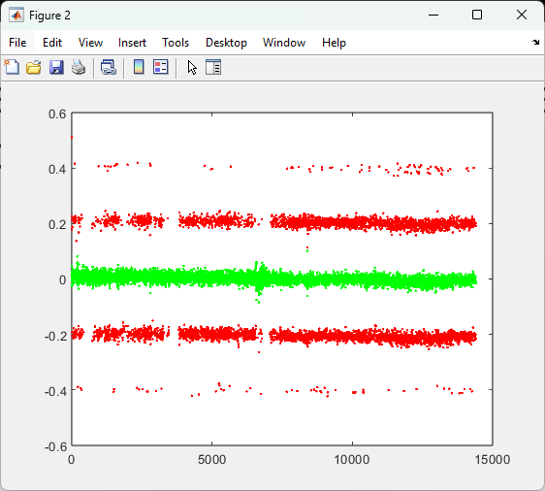
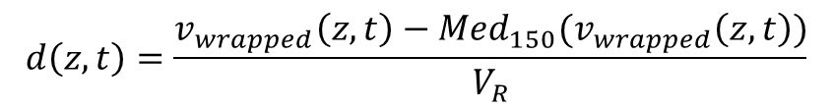
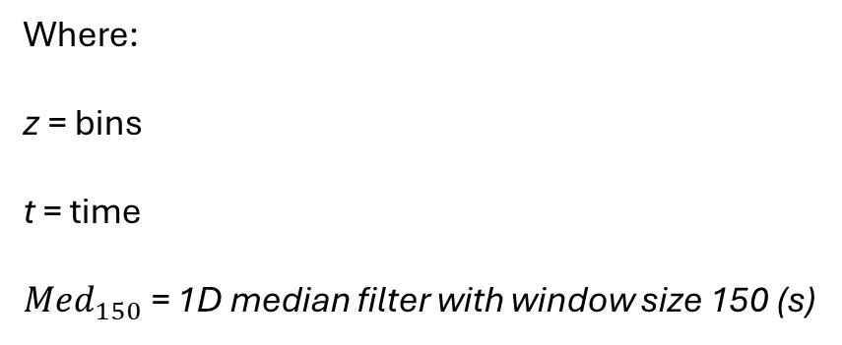
Mean-Filtering for Detecting Suspected Wrapped Velocities
$$d\left(z, t\right)=\frac{v_{wrapped}\left(z,t\right)−Med_{150}(v_{wrapped}\left(z,t\right))}{V_{R}}$$
$$suspect_{pts }(z,t)=\left|d\left(z,t\right)\right|>1$$
Where:
z = bins
t = time
$Med_{150}$ = 1D median filter with window size 150 (s)
Source: Shcherbina et al 2018

Slide 6
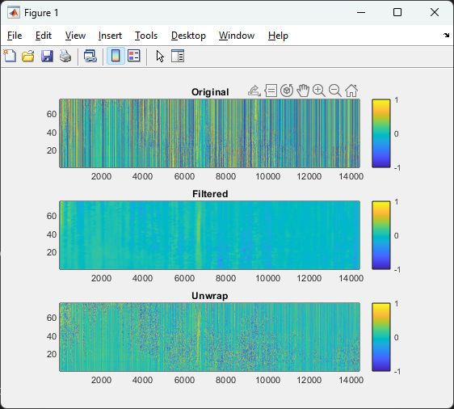
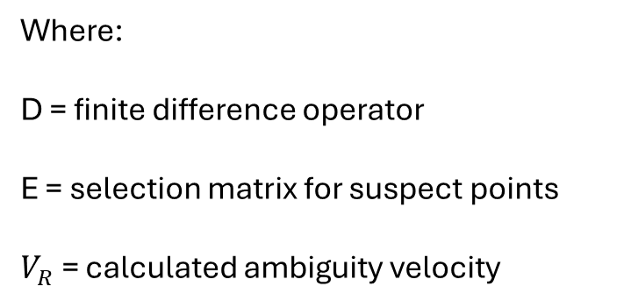
Using Integer Linear Least Squares Minimization Problem to Correct Phase Wrapped Points
$$r≈{\left(2V_{r}DE\right)}^{−1}v^{′}$$
$$v_{unwrap}=v_{wrapped}−2V_{R}r$$
Where:
D = finite difference operator
E = selection matrix for suspect points
$V_{R}$ = calculated ambiguity velocity
Source: Shcherbina et al 2018

Slide 7
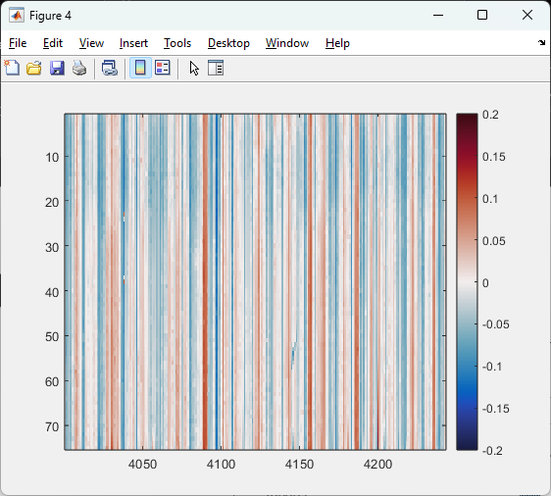
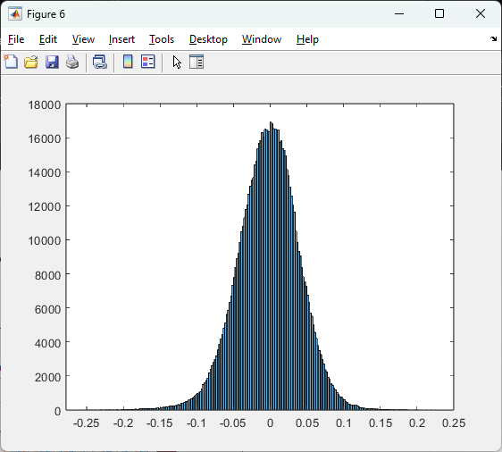
Corrected Data

Slide 8
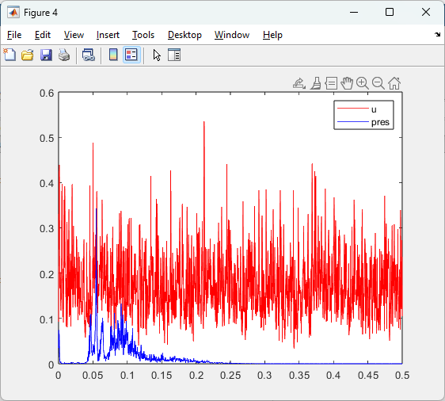
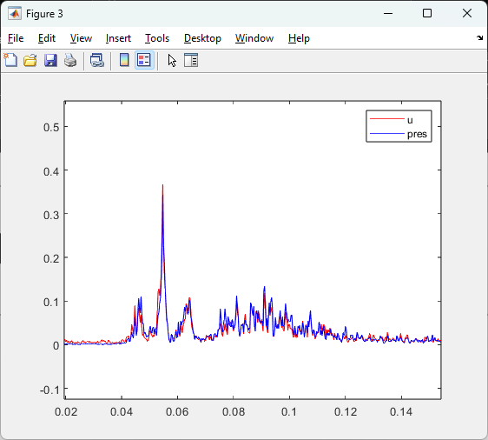
Frequency Distribution: Raw Vs. Unwrapped
Raw Beam 1 Velocity
Unwrapped Beam 1 Velocity

Slide 9
Sources
Shcherbina, A. Y., D’Asaro, E. A., & Nylund, S. (2018). Observing finescale oceanic velocity structure with an autonomous Nortek acoustic Doppler current profiler. Journal of Atmospheric and Oceanic Technology, 35(2), 411–427. https://doi.org/10.1175/JTECH-D-17-0108.1

Slide 10
